Slide 1
Why Emerging Markets Will Outperform Developed Markets Over the Next 12-36 months Thomas J. Hayes
Chairman and Managing Member of Great Hill Capital LLC
Contact: 212-951-1478, tjh@greathillcapital.com, HedgeFundTips.com

Slide 2
Our Strategy (simplified)
Who are we?
Great Hill Capital, LLC runs a long/short equity strategy in SMA format for Accredited Investors and Qualified Institutions.
We’ve developed a reputation over time for benefitting from sector, stock and general market dislocations in periods of distress.
HedgeFundTips.com is where we post our weekly market outlook and research notes.
“Hedge Fund Tips with Tom Hayes” podcast is ranked #1 in the Hedge Fund Category via feedspot
We make our money buying on weakness and selling on strength.
Our confidence to step in when others are bailing is rooted in deep research and the premise that the more price becomes dislocated the more risk that has COME OUT.
Most market participants see increased volatility as increased RISK. We view it as increased OPPORTUNITY.

Slide 3
1.5 Decades in Hedge Funds – Long/Short Equity
Great Hill Capital, LLC – Chairman & Managing Member
Cornwall Capital, LP – “The Big Short”
COO – Chief Operating Officer – Public Company
Purchased Asset Manager $1,600,000,000 AUM
Columbia University

Slide 4
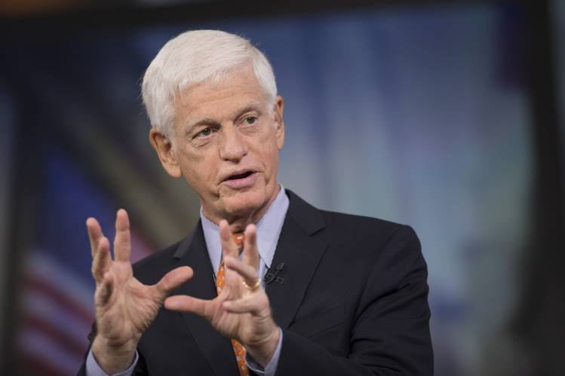
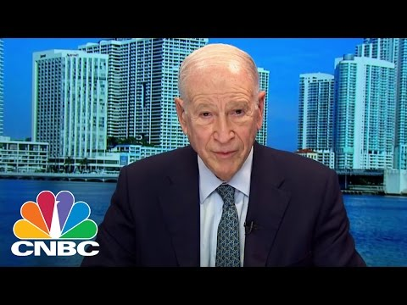
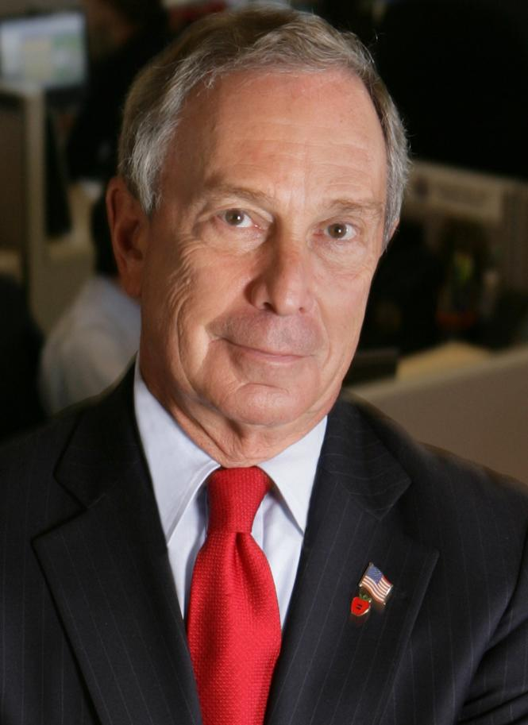
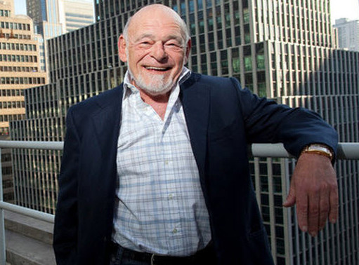
Bedford Oak Advisors, LLC

Slide 5
2002-2007 redux?

Slide 6
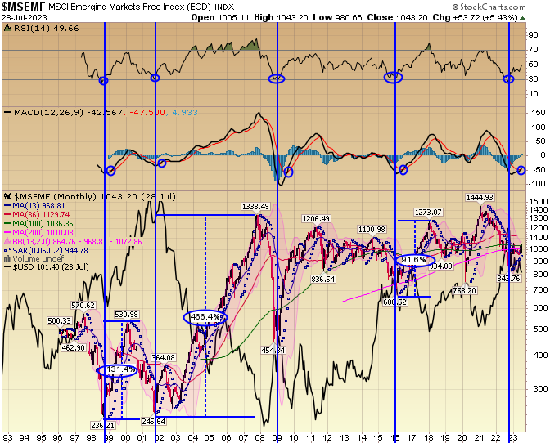
Relationship to USD:

Slide 7
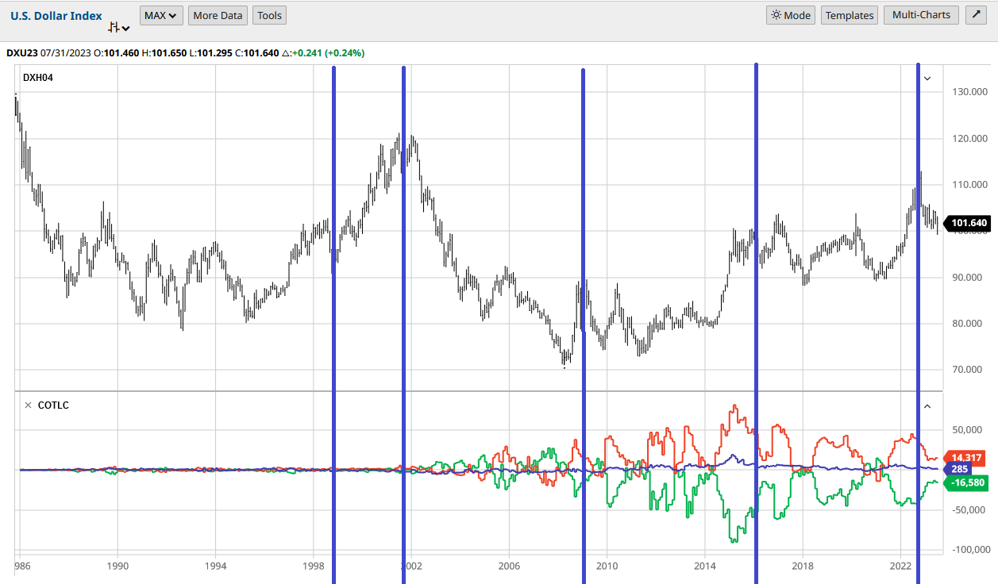
COT Positioning/USD impact

Slide 8
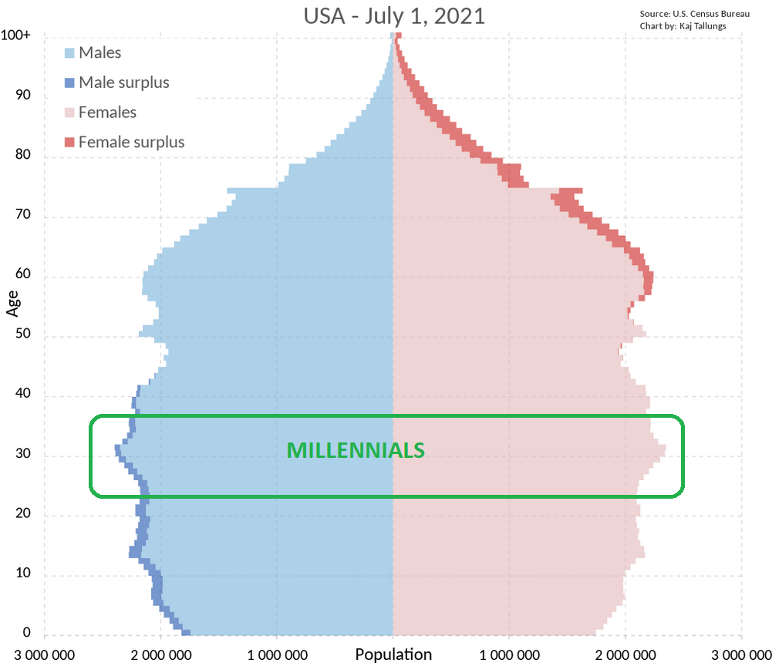
Demographics Drive Destiny

Slide 9
More Room to Run
We are halfway through the secular bull run (h/t RBC)
Age demographics
Millennial housing and family formation

Slide 10
China Is Biggest Weight in Emerging Markets

Slide 11
~40% China

Slide 12
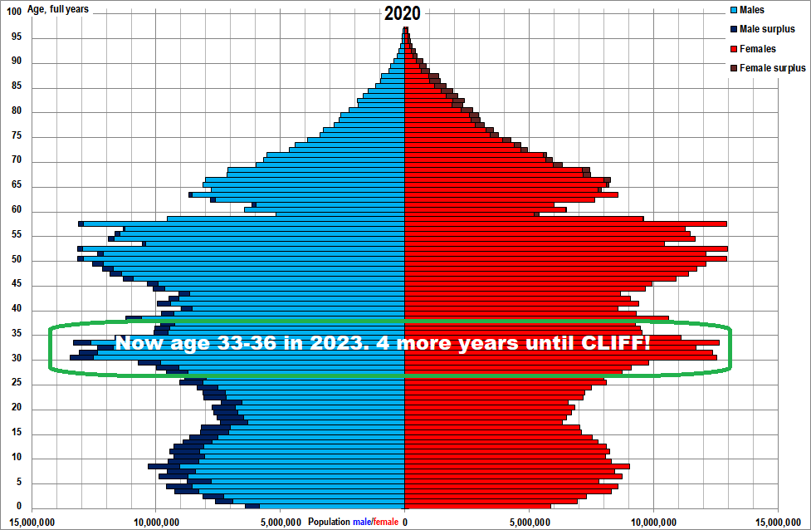
China Population base
Young and Growing Population. 4 years of Runway until Demographic CLIFF like Japan in 1989.

