Slide 1

“Turnaround Tom’s” ‘Top Picks' and Outlook for 2024

Slide 2
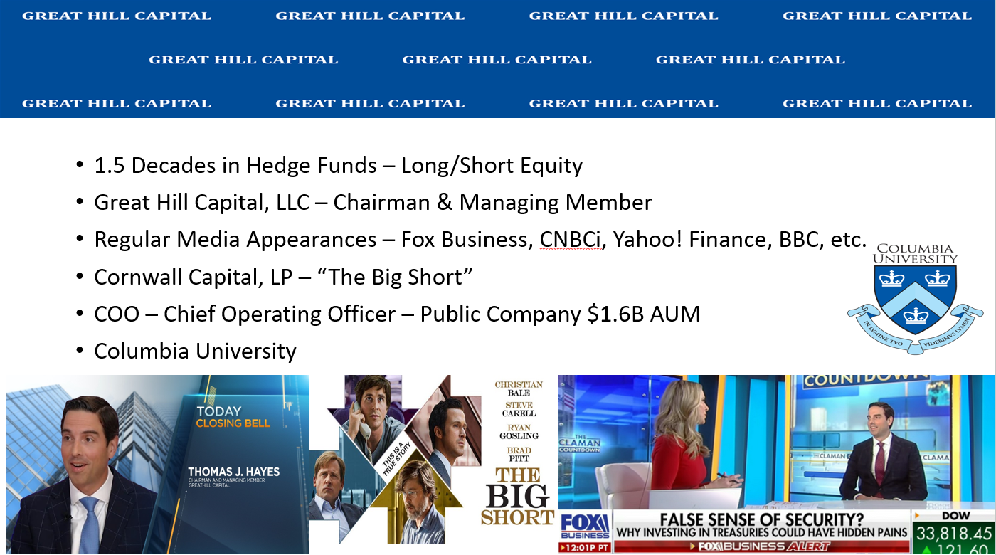

Slide 3
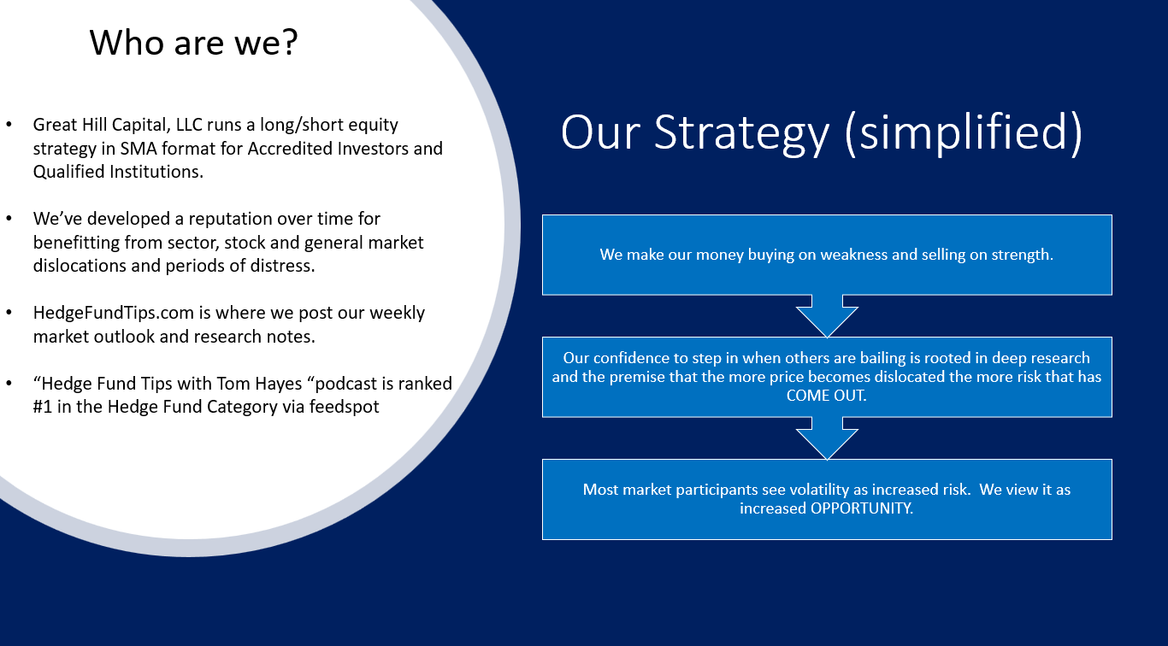

Slide 4
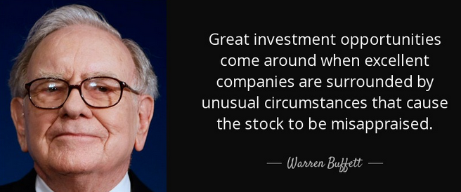
Our Investment Philosophy in a Nutshell:

Slide 5
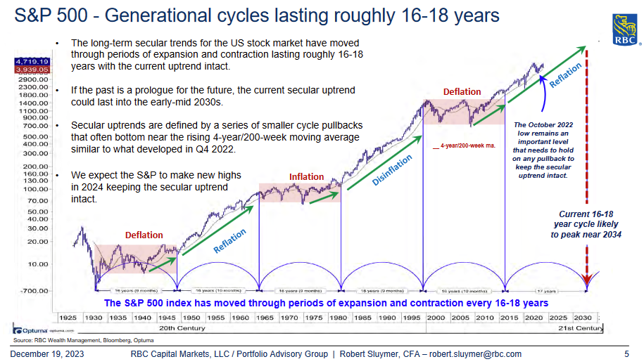
The Big Picture… 2024 and Beyond…

Slide 6
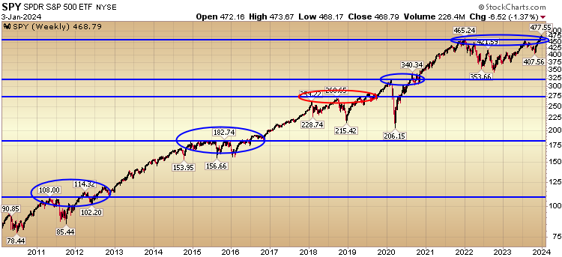
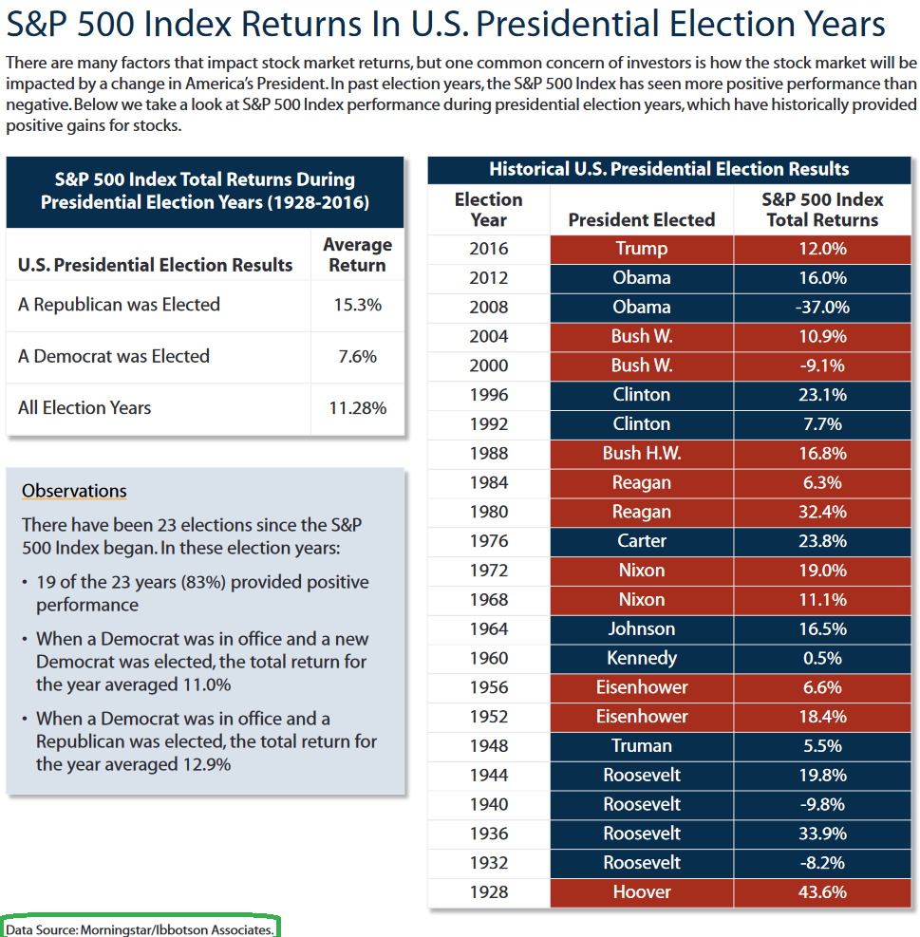
2 year of consolidation (normal):

Slide 7
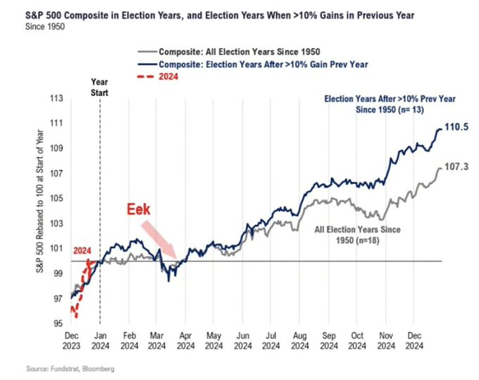
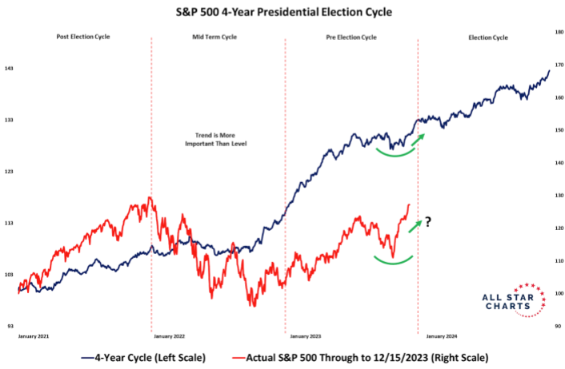
Where are we in the process?

Slide 8
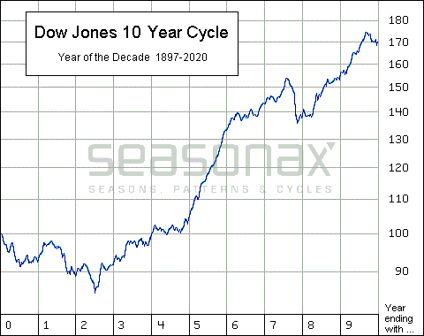
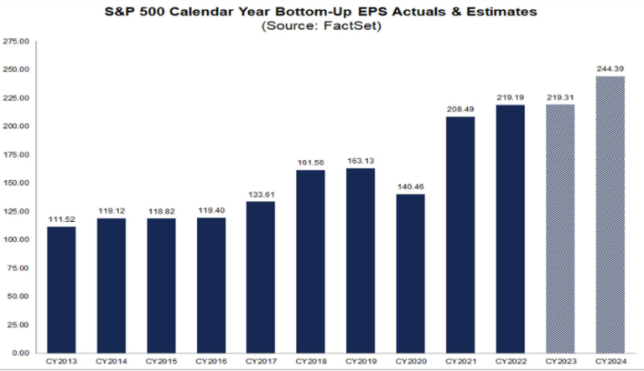
Seasonality and Earnings

Slide 9
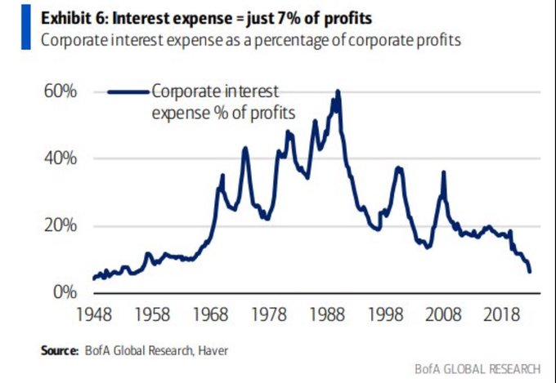
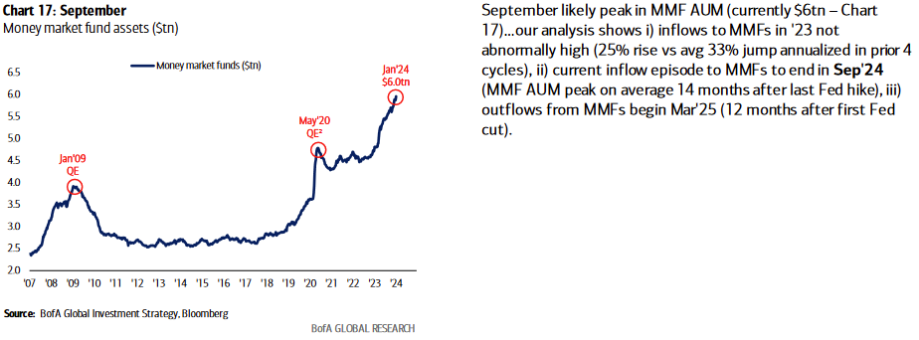
Dry Powder and Interest Expense

Slide 10
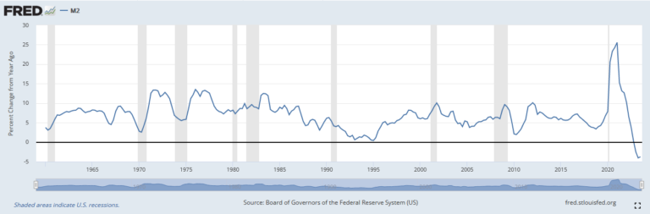
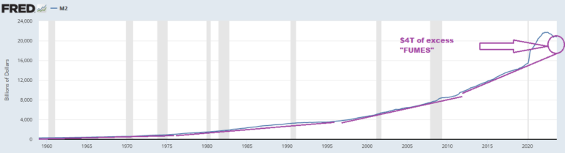
Money Supply Contraction Fears Overblown

Slide 11
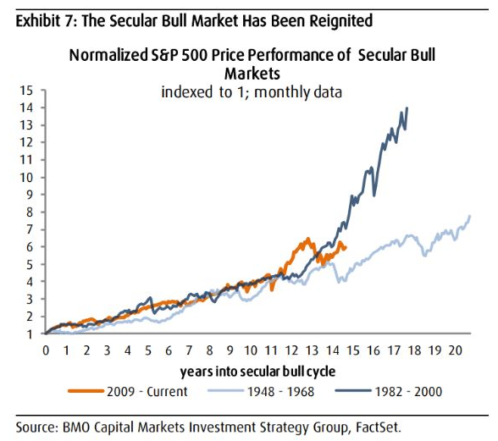
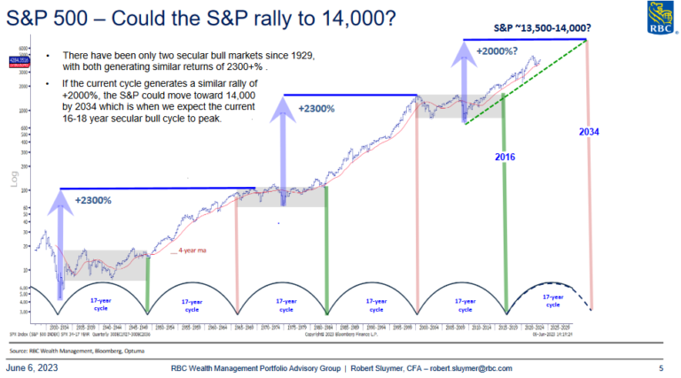
Take The Long View (Demographics) UPSIDE!

Slide 12
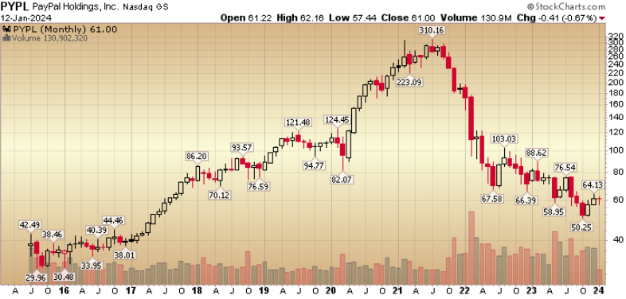
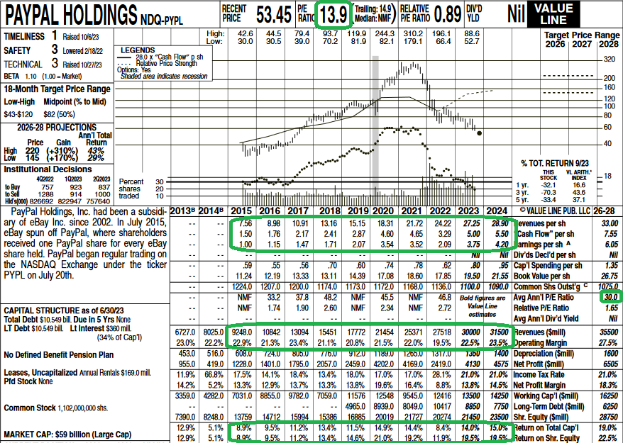
Turnaround Tom Pick: Paypal
Stock down 80%. Revenues, Earnings and Cashflow GROWING!

Slide 13
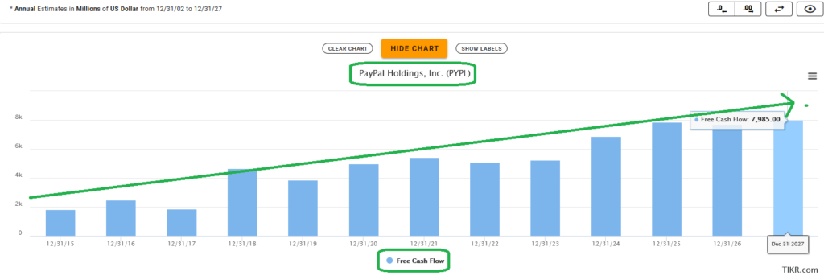
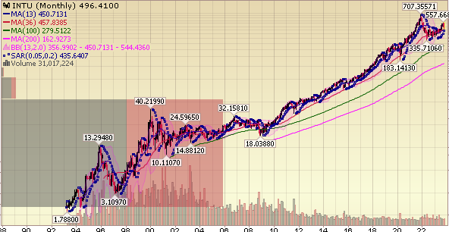
What’s the Problem? What’s the Solution?
Problem is fear about declining margins and increased competition.
Solution Catalysts for Change:
- BET ON JOCKEY: New CEO - Alex Chriss – 9/27/2023 - Ran Small Business div. at INTU. Responsible for 50% of Revs. 2008-2023 when the company peaked at a 38x – bagger ($18 to $707). PYPL= Growth Co
- PayPal generated$5.2B in FCF in TTM alone.

Slide 14
Path to ~$150+
Braintree margins stabilizing and begin inflection Q4.
Firing unprofitable customers (LatAm) focused on profitable growth.
428M active accounts
10% Global Enterprise business $500B (Uber, TicketMaster, Adobe).
TPV (Total Payment Vol) up 15% yoy, Revs up 8%
FY ‘23 buybacks $5B
PYPL/USD Stablecoin oppty + partnership with Kraken. BNPL growing.
Venmo is a verb. Kleenex, FedEx, Uber, etc
Focus on PROFITABLE growth. Cut expenses, implement efficiencies.

Slide 15
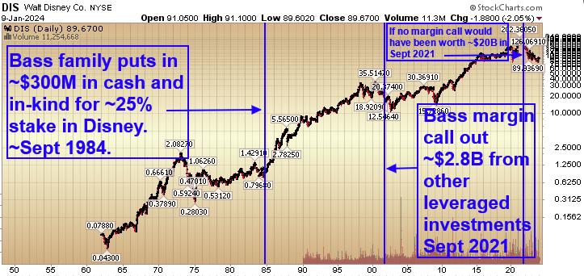
Disney: History Repeats
Bass Family/Rainwater invest $300M in 1984.
Same problems: Parks stale, Legacy IP underutilized, creativity in a slump, Media struggling
Appoint Eisner: Turnaround includes –
- “New Technology” VCR tape to sell OLD Classic Disney IP.
- Raised Ticket Prices
-Hired Jeffrey Katzenberg to resuscitate Disney Animation. Lion King/Beauty & Beast
-Expanded Hotels and Theme Parks Internationally (Paris/Hon Kong)
-Profits 4x in 10 years. $300M became worth as much as $5.8B late ‘90s

Slide 16
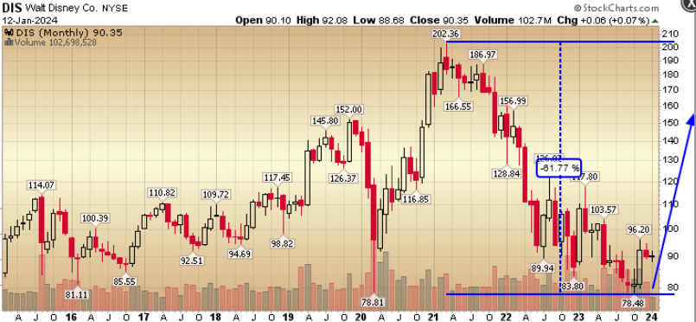
Same ________, Different Date: It Works!
Theme Parks (high ROIC) & Consumer Products Business $10B EBIT worth ~$80 per share
Implication: ESPN (1 share in sports & growing), Theatrical Movies, Disney+ Hulu and TV networks worth $ZERO?
ValueAct Turned Spotify and NYTimes with tier pricing/packages. Will do same with Disney bundle
Also oversaw succession plan w/MSFT to Satya Nadella. CRM margins 18-32% in 10 months.
Streaming is the new VHS Tape.
$60B in parks and experiences CapEx
$7.5B cost cuts
FCF to pre-pandemic levels in 2024.
Content Quality versus Quantity.

Slide 17
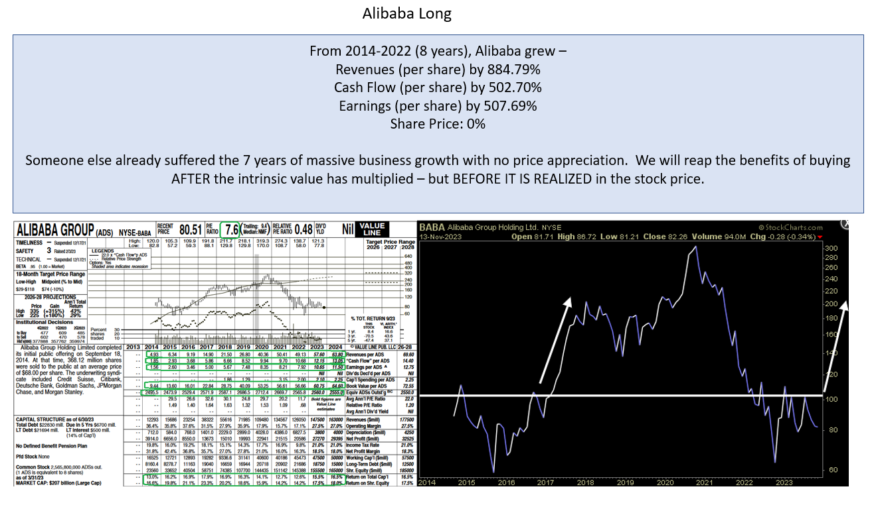
Emerging Markets (Value) Best Idea

Slide 18
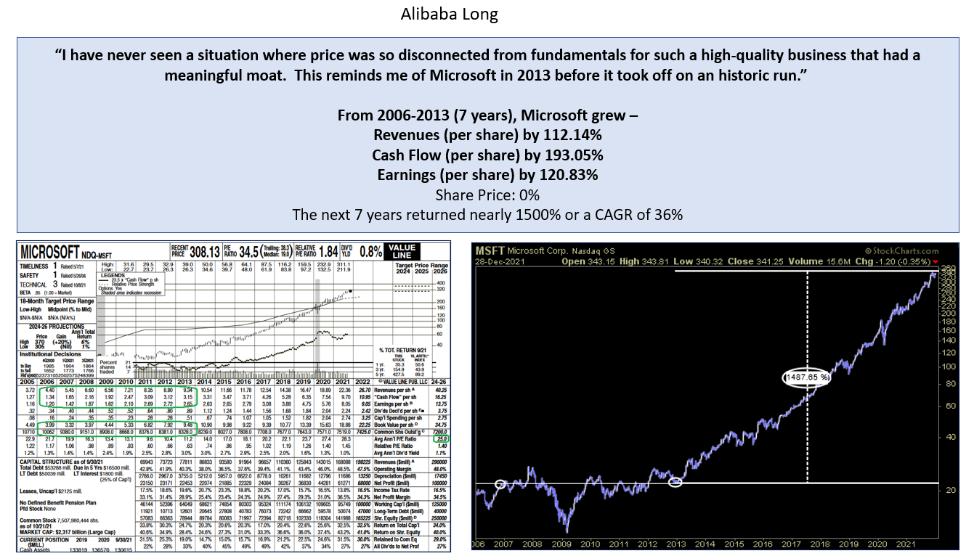

Slide 19
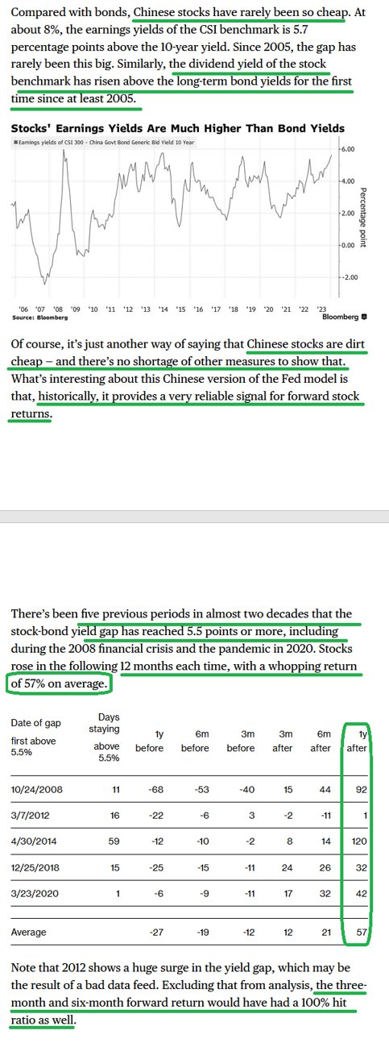
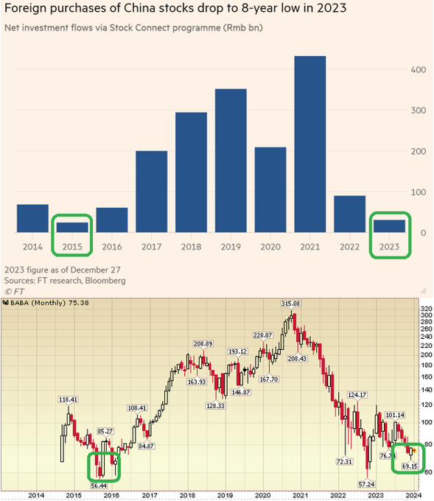
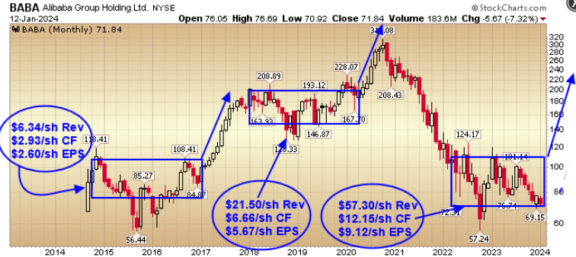
Voting Machine vs. Weighing Machine

Slide 20
Thank You! *Opinion, Not Investment Advice.
Tom Hayes – Chairman & Managing Member - Great Hill Capital, LLC
“Hedge Fund Tips with Tom Hayes” Top Ranked Podcast
Twitter: @HedgeFundTips
YouTube: Search “Hedge Fund Tips”
Contact: tjh@greathillcapital.com 212-951-1478

